Slide 1
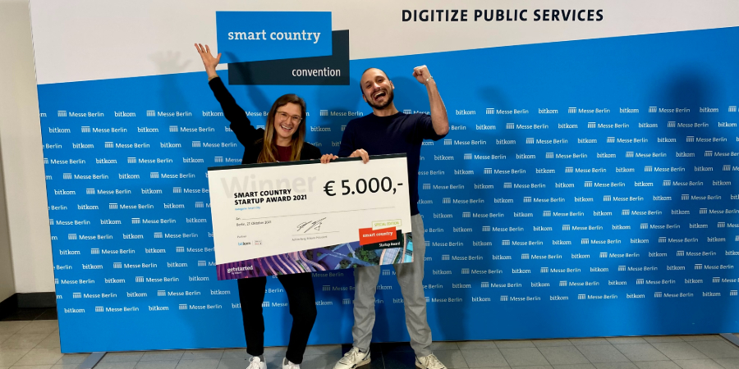
Quelle: Smart Country Convention

Slide 2
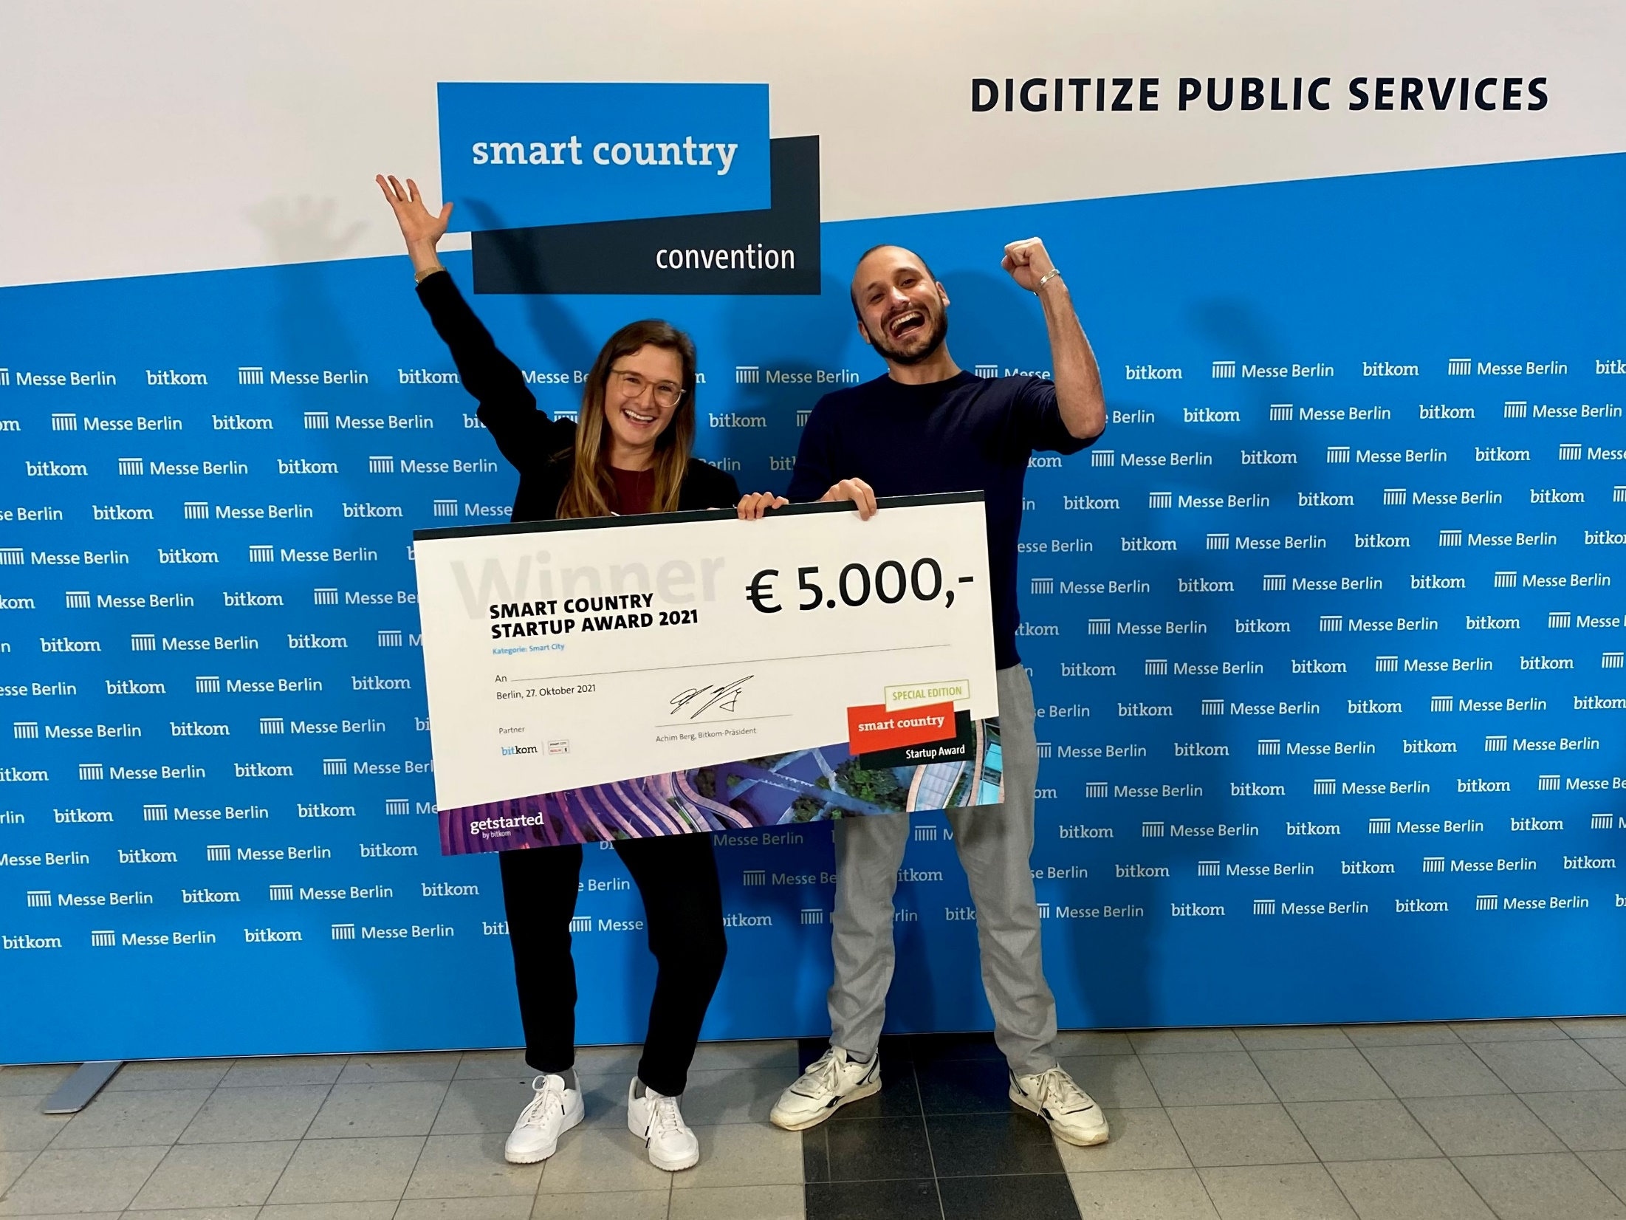
Quelle: Smart Country Convention

Slide 3

Quelle: Smart Country Convention

Slide 4

Quelle: Smart Country Convention

